Slide 1
Uniform Seam Welding with Robot-Robot Collaboration

Slide 2

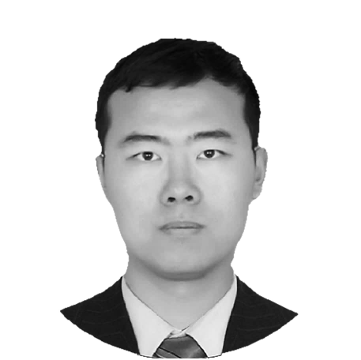

Researchers
JIANI
Civil Engineer
ZONGHAI
Civil Engineer
LENI
Computer Scientist

Slide 3
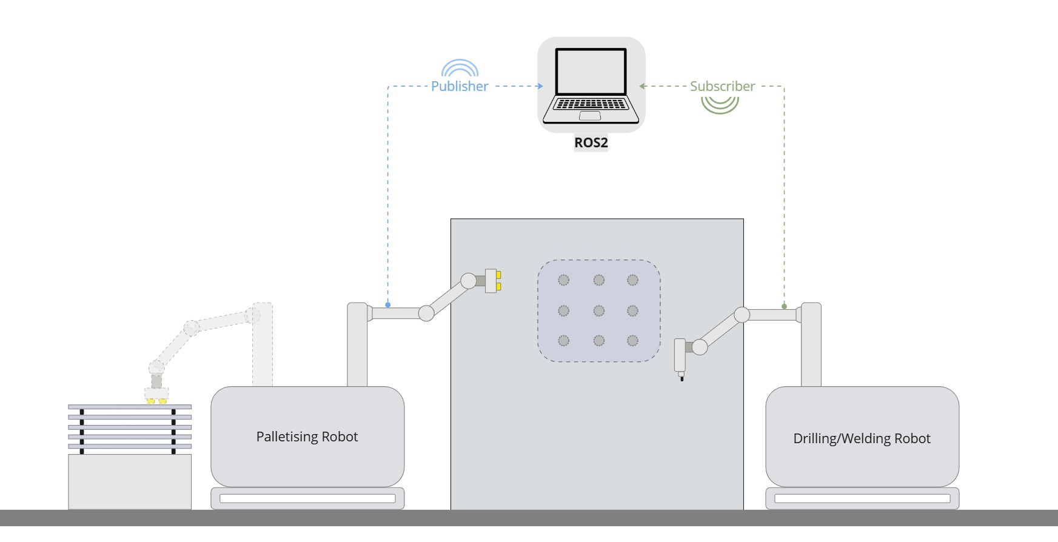
The goal of the project was to create controller for two robotic manipulators.
Our focus was to write a logic to:
make both robots move in the same environment
grab an object
avoid collision with each other
Leader
Positioner Robot
Follower
Welder Robot

Slide 4
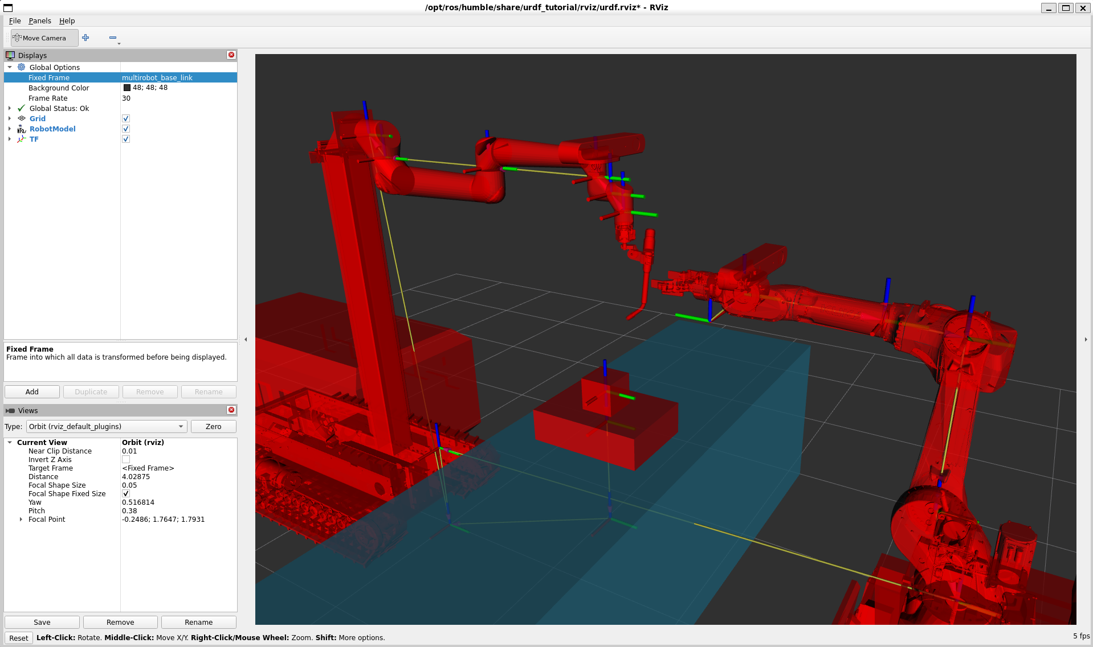
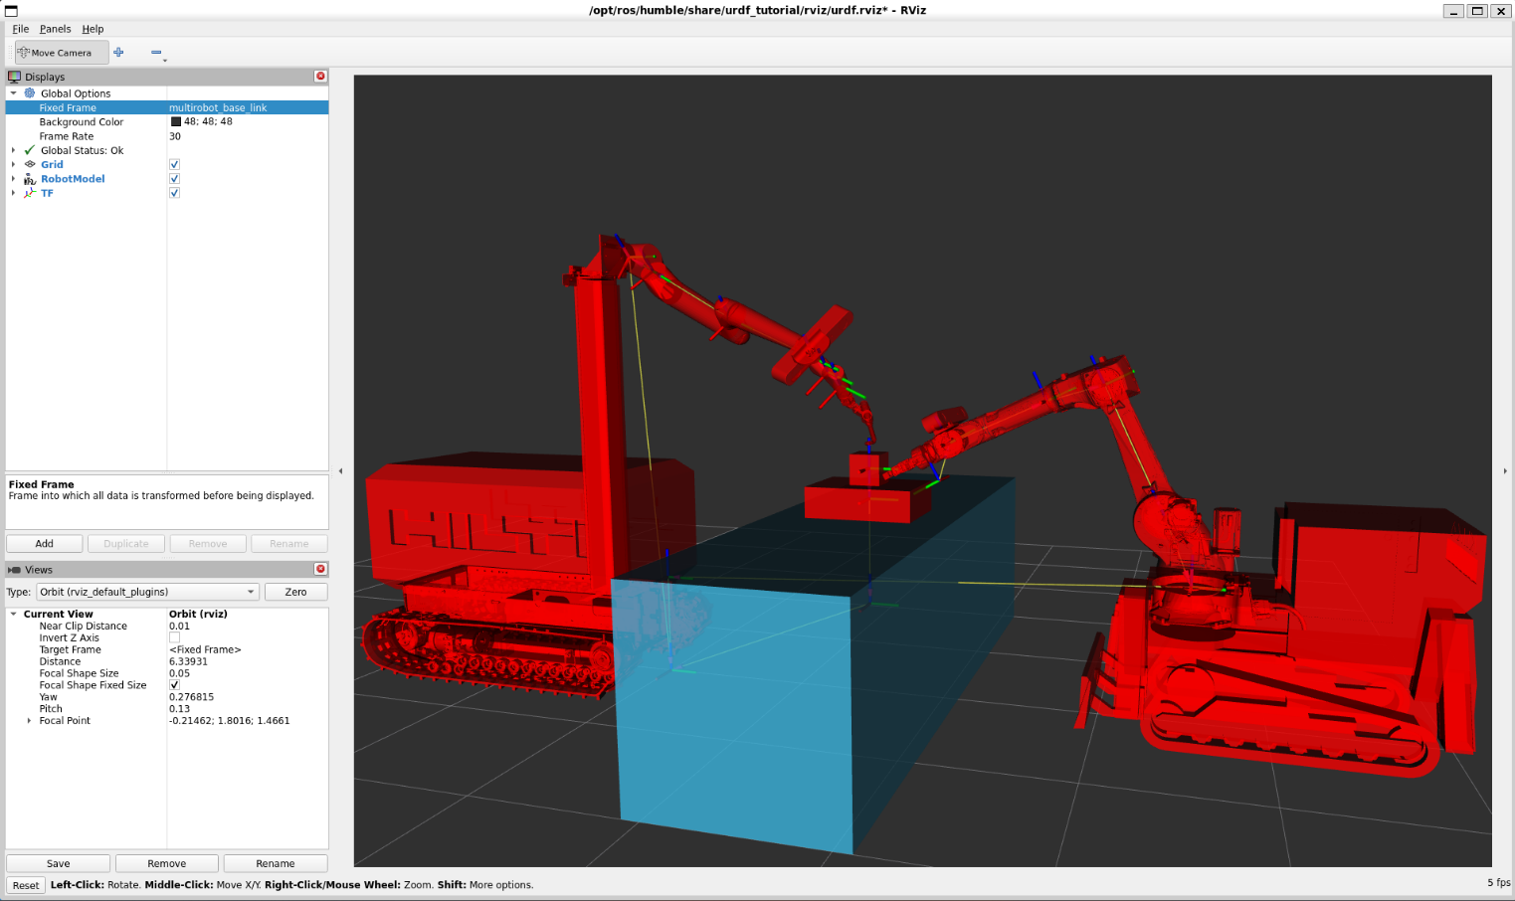

Slide 5
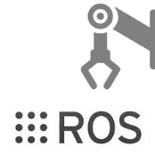





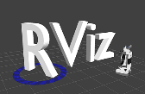

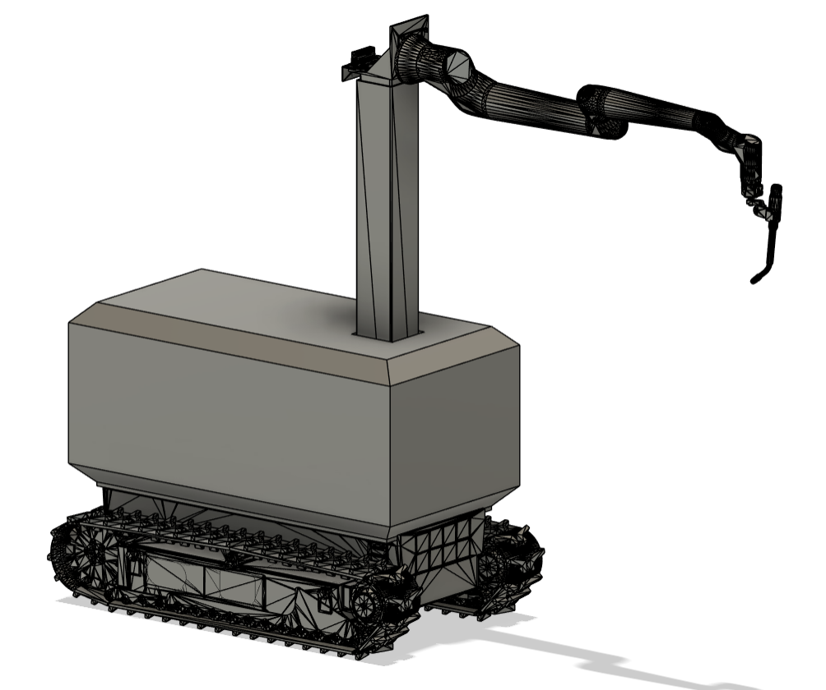
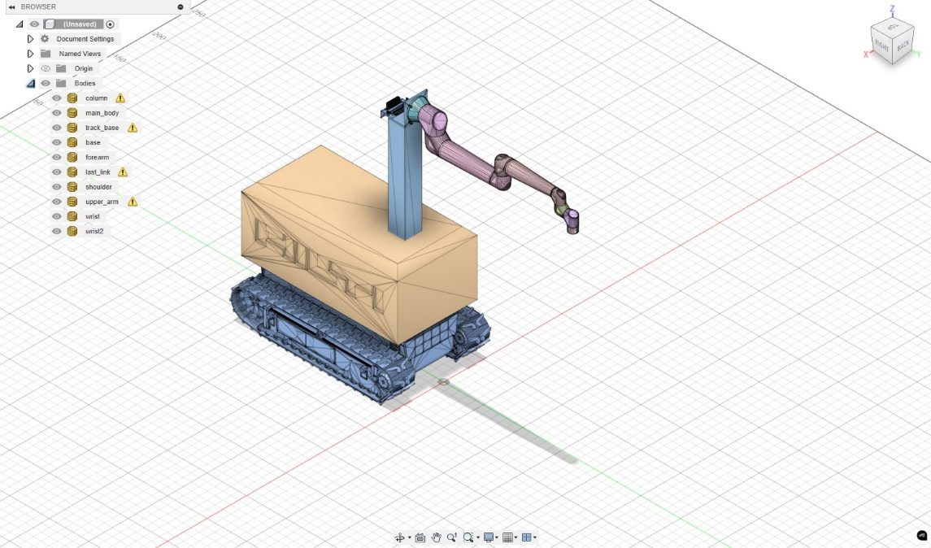
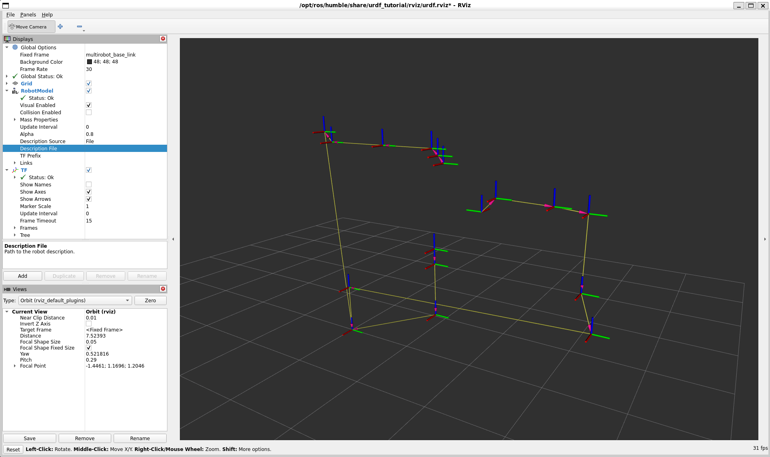
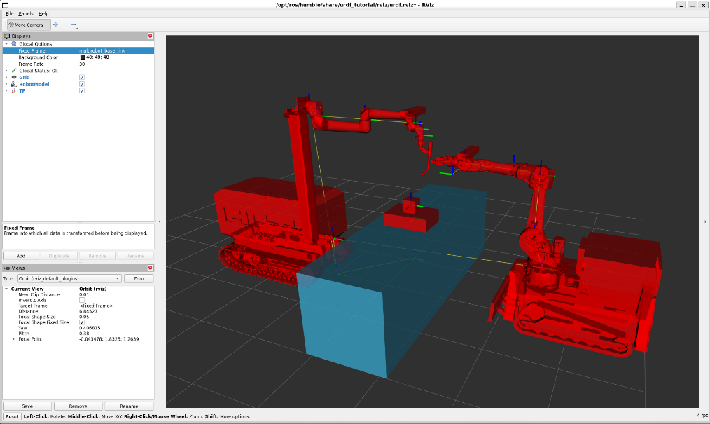
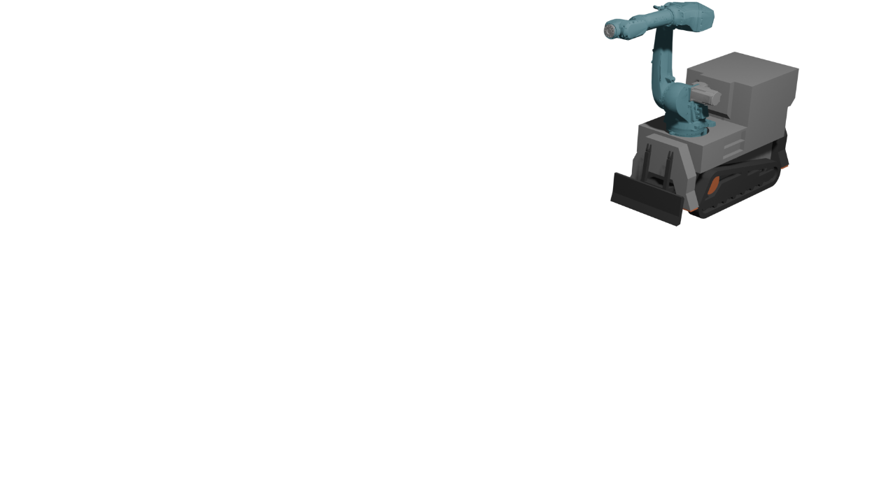
Solid Model
Meshes
URDF + SRDF + TF Tree
Kinematic Manipulation

Slide 6
URDF
SRDF
Kinematics
Dynamics
Sensors
Positioning in reference to 3D world
Motion Planning Groups
Defining End Effector
Links
Mass
Joints
Inertia
Grasping
Joint Types and Limits
Collision Geometry
Predefined Poses
Actuator Parameters

Slide 7
ROS Nodes
Joint Angles
Lookup
Robot State
RViz
Launch

Slide 8
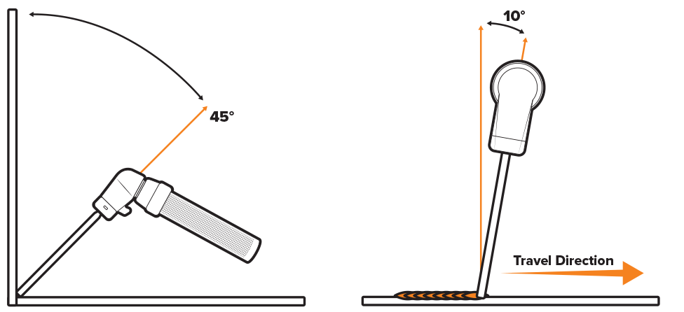
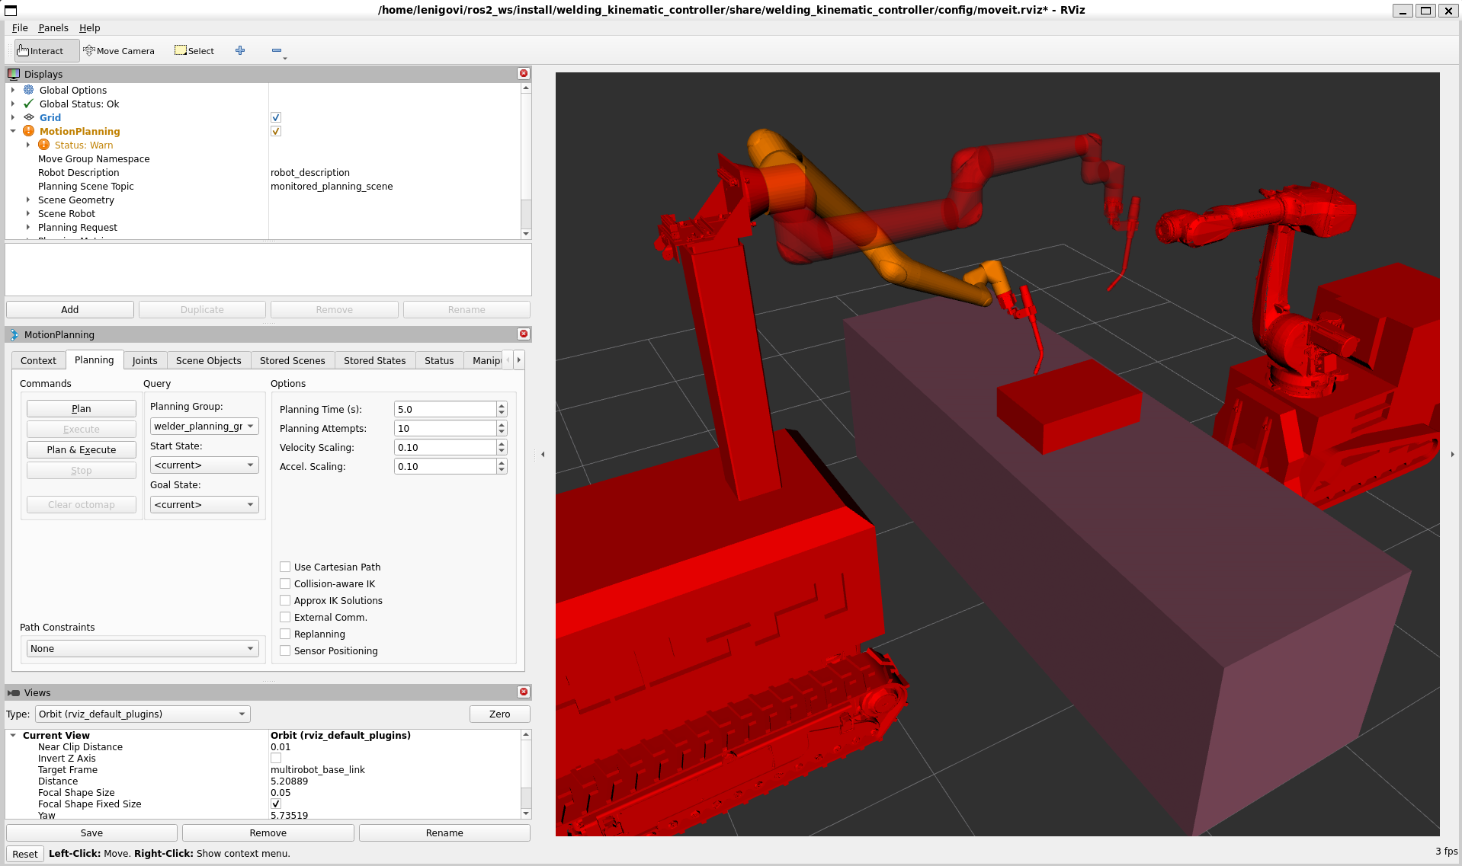
The three main components of our project are:
Controller input
Collision avoidance
Inverse kinematics
Joint angles
End effector angle

Slide 9
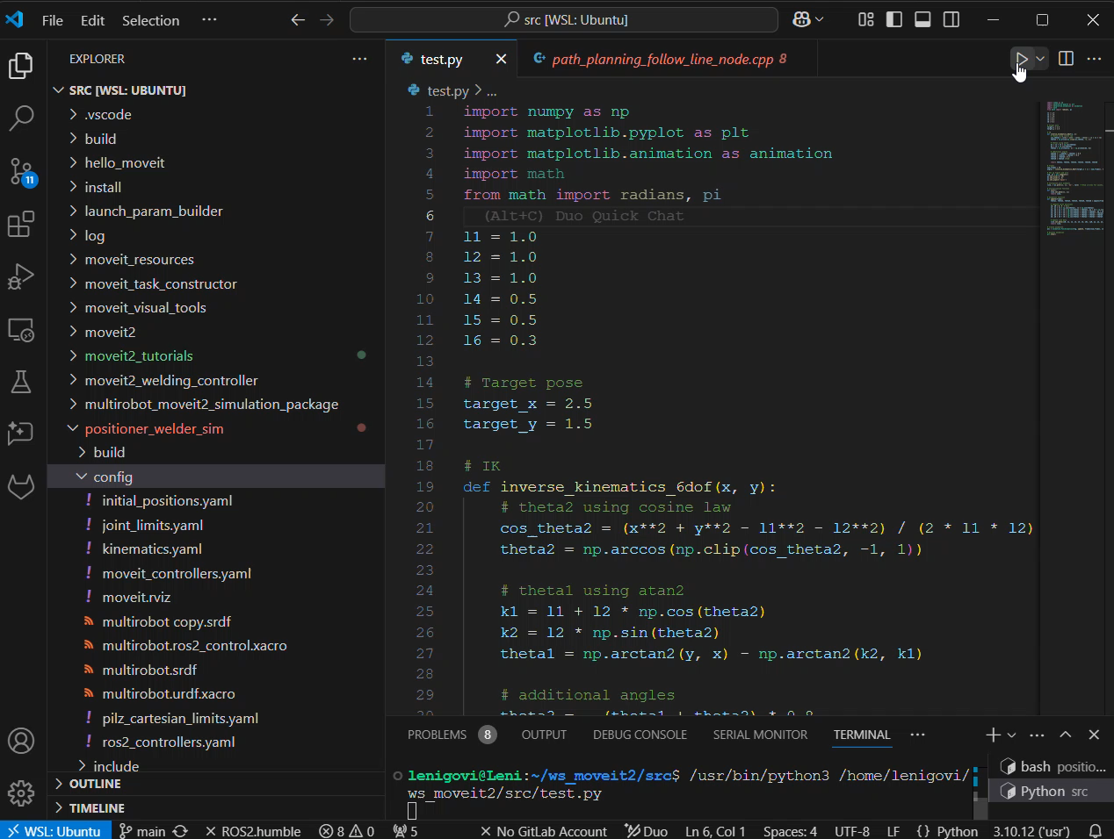
First Challenge: Inverse Kinematics Solution

Slide 10
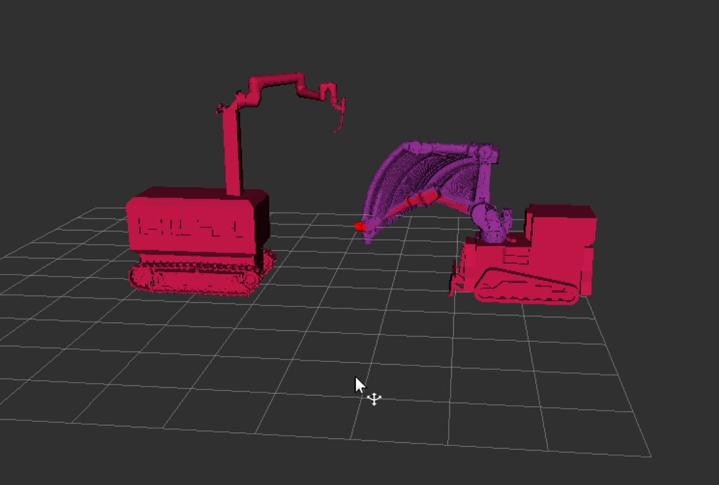
Second Challenge: Moving Two Robots in one 3D Environment
The action space of the Positioner is mapped as cartesian path. Based on this value, Welder path is updated and robot motion is realized.

Slide 11
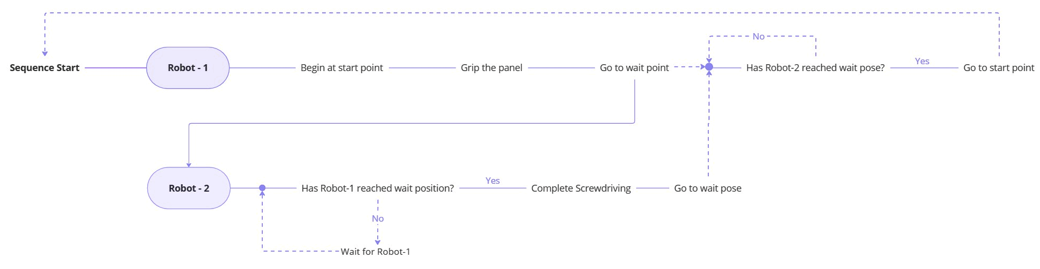
Second Challenge: Sequence
Dynamically Adjusted Poses: Completion of One Sequence
Sources
Figure-1 (top): Our own work

Slide 12


Slide 13


Slide 14
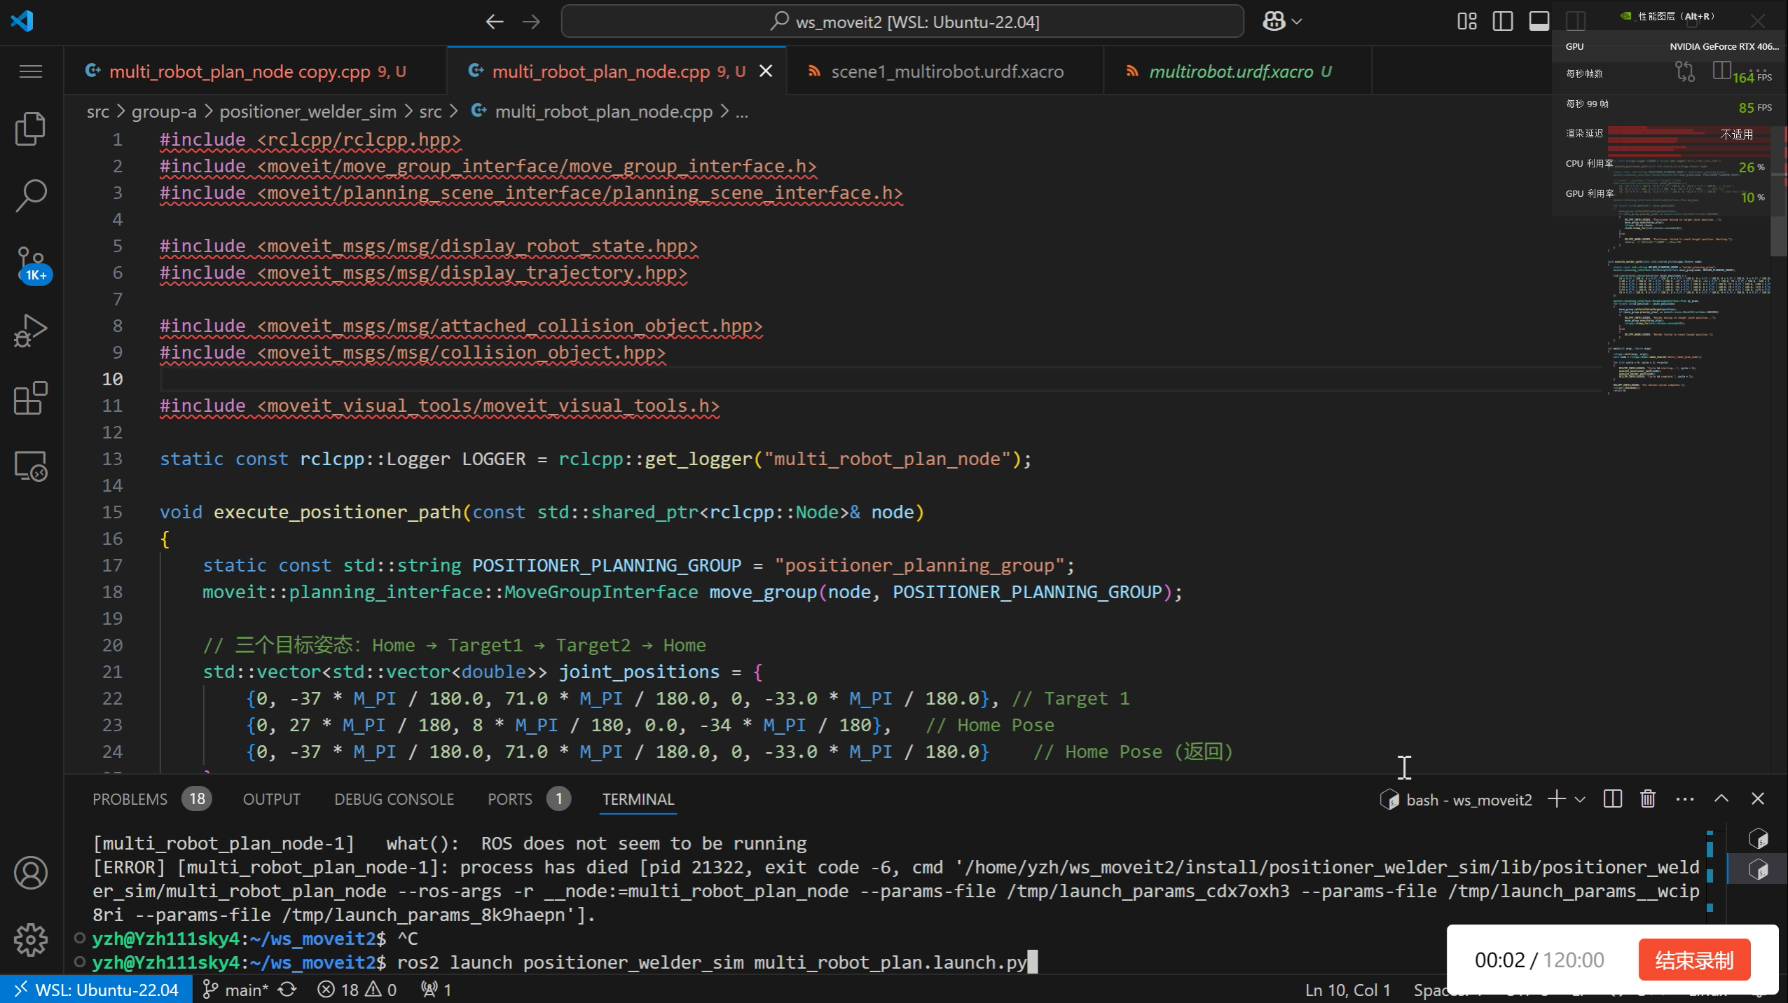

Slide 15
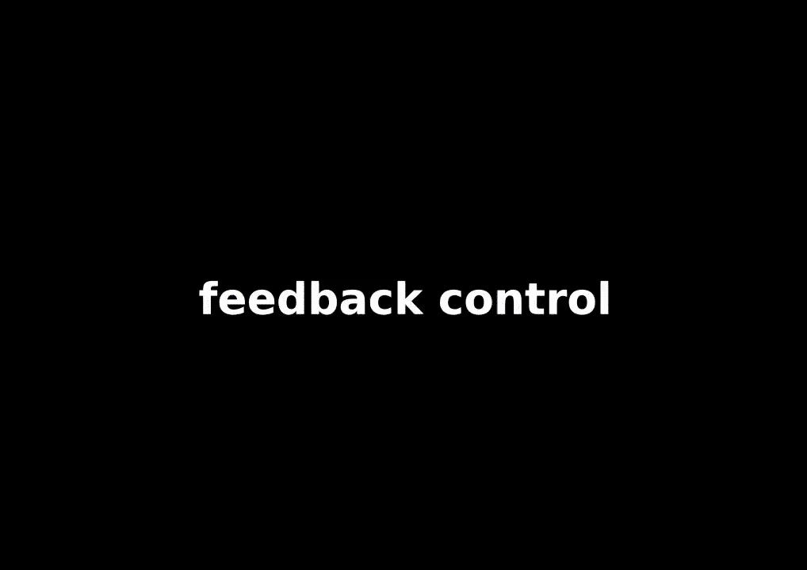
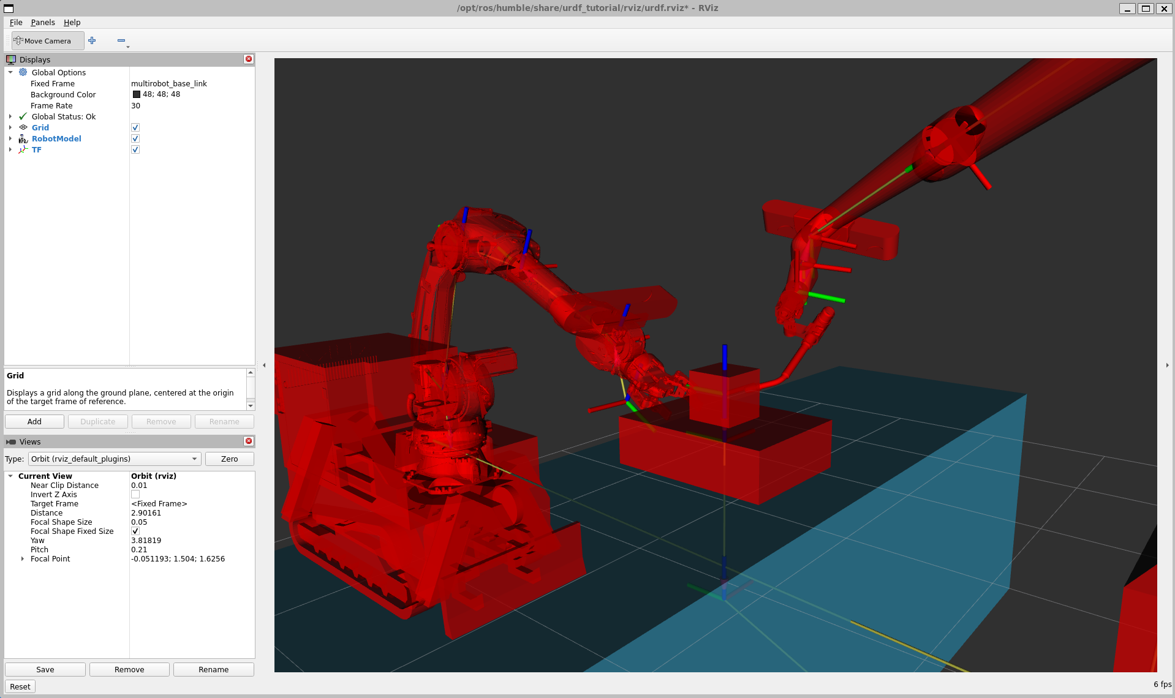
Next Steps
Edge Detection and Seam Tracking
Sources
Figure (left): Romi-Lab, Robotic Sealing (2021) https://github.com/romi-lab/robotic-sealing

Slide 16
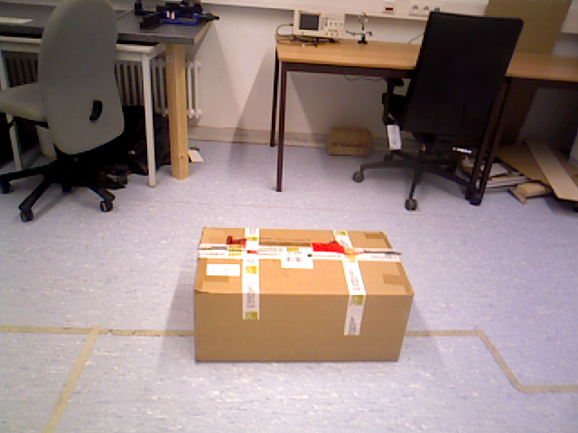
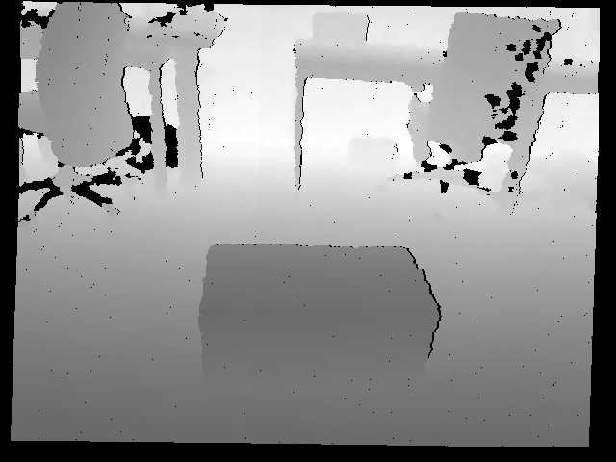
Next Steps
Step 9: Edge Detection and Seam Tracking
Using depth images to extract the coordinates of an object, the calibration of the RGB camera is the following:
fx=542.822841
fy= 542.576870
cx=315.593520
cy= 237.756098
d0 =0.039903
d1 =-0.099343
d2 =-0.000730
d3 =-0.000144
d4=0.000000
Sources
Figure-1 (Mid) : RGB Image
Figure-2 (Right): Depth Image
Notes:
45-degree angle selection Challenge：During welding, the object's edge shape can result in four potential 45-degree solutions. Inner and outer edge detection cannot ensure accurate angles.

Slide 17
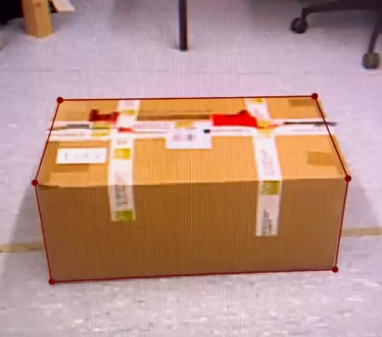
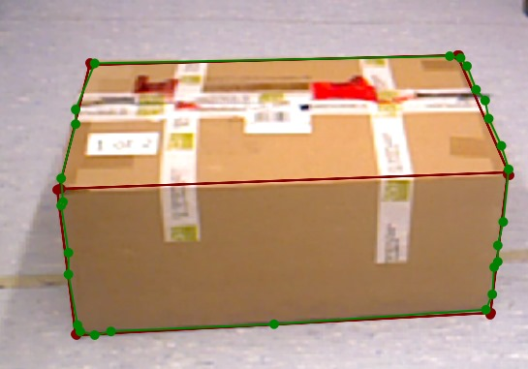
Next Steps
Step 9: Edge Detection and Seam Tracking
Sources
Figure-1 (Left): Edge the dataset
Figure-2 (Mid): Training
Notes:
Our solution: Place the object on a larger reference surface to create a 90-degree angle, allowing geometric bisection for the desired 45-degree direction. In the future, we plan to add depth camera to reach the goal of real-time seam tracking.

Slide 18
Thank you for your Attention

